Slide 1
Android Overview
History and architecture

Slide 2
Brief History
1996
The WWW already had websites with color and images
But, the best phones displayed a couple of lines of monochrome text!
Enter:
Wireless Application Protocol (WAP) – stripped down HTTP for bandwidth reduction
Wireless Markup Language (WML) – stripped down HTML for content

Slide 3
Continued..
Many issues (WAP = “Wait And Pay”)
Few developers to produce content (it wasn’t fun!)
Really hard to type in URLs using the small keyboards
Data fees frightfully expensive
No billing mechanism – content difficult to monetize
Other platforms emerged
Palm OS, Blackberry OS, J2ME, Symbian (Nokia), BREW, OS X iPhone, Windows Mobile

Slide 4
Brief History - Android
2005
Google acquires startup Android Inc. to start Android platform
Work on Dalvik VM begins
2007
Open Handset Alliance announced
Early look at SDK
2008
Google sponsors 1st Android Developer Challenge
T-Mobile G1 announced
SDK 1.0 released
Android released open source (Apache License)
Android Dev Phone 1 released

Slide 5
Brief History cont.
2009
SDK 1.5 (Cupcake)
New soft keyboard with “autocomplete” feature
SDK 1.6 (Donut)
Support Wide VGA
SDK 2.0/2.0.1/2.1 (Eclair)
Revamped UI, browser
2010
Nexus One released to the public
SDK 2.2 (Froyo)
Flash support, tethering
SDK 2.3 (Gingerbread)
UI update, system-wide copy-paste

Slide 6
Brief History cont.
2011
SDK 3.x (Honeycomb)
Optimized for tablet support
SDK 4.0 (Ice Cream Sandwich)
Virtual UI buttons
2012
SDK 4.1.1 (Jelly Bean)
Triple buffered graphics pipeline

Slide 7
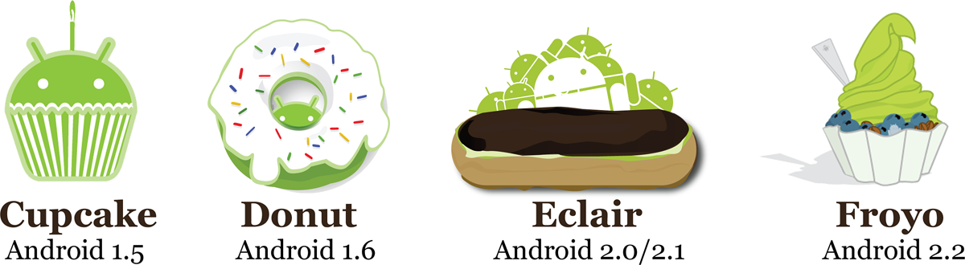
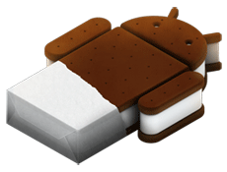

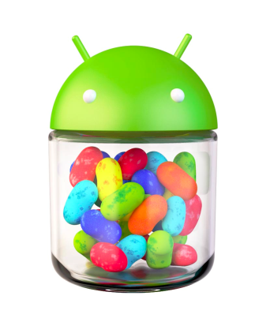
Brief History cont.
2011
SDK 3.0/3.1/3.2 (Honeycomb) for tablets only
New UI for tablets, support multi-core processors
SDK 4.0/4.0.1/4.0.2/4.0.3 (Ice Cream Sandwich)
Changes to the UI, Voice input, NFC
Ice cream Sandwich
Android 4.0+
Honey comb android 3.0-3.2
Jelly bean Android 4.1.1

Slide 8
What is Google Android?
A software stack for mobile devices that includes
An operating system
Middleware
Key Applications
Uses Linux to provide core system services
Security
Memory management
Process management
Power management
Hardware drivers

Slide 9
Android Design Philosophy
Applications should be:
Fast
Resource constraints: <200MB RAM, slow processor
Responsive
Apps must respond to user actions within 5 seconds
Secure
Apps declare permissions in manifest
Seamless
Usability is key, persist data, suspend services
Android kills processes in background as needed

Slide 10
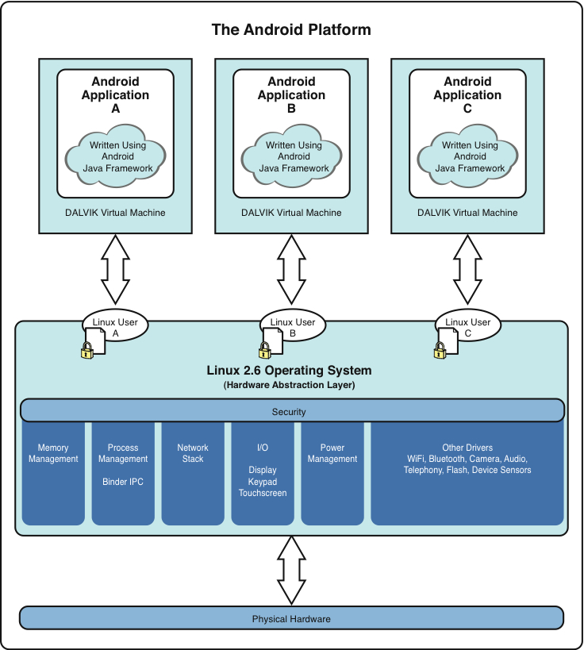
Android Architecture

Slide 11
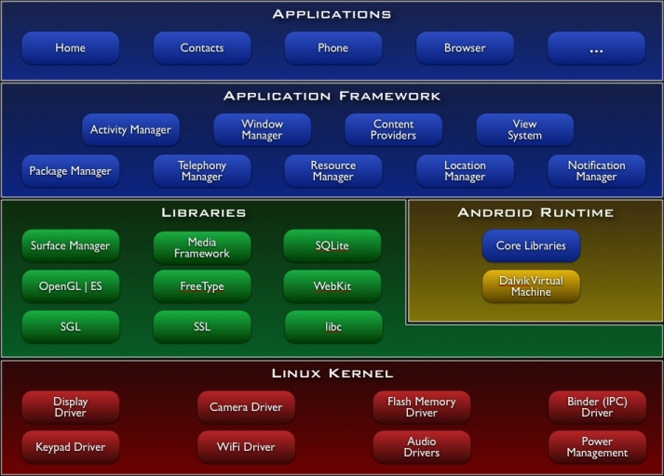
Android Architecture

